Slide 1


LASSO REGRESSION
By :-
Bharath Kumar N

Slide 2


WEEKLY AGENDA
Week - 1
Week - 2
Week - 3
Week - 4
Week - 5
Week - 6
Week - 7

Slide 3








OUR AGENDA IN BRIEF
WEEK 1
WEEK 3
WEEK 5
WEEK 7
understand the mathematical logic
implement algorithm without sklearn
implement algorithm without sklearn
Build an interface and deploy
Internship
FINAL
VERSION
WEEK 2
WEEK 6
WEEK 8
Understand the coding implementation
WEEK 4
Test on 5 datasets and compare execution time
Presentation
Hyper parameter tuning/ Generalized model

Slide 4

*
TABLE OF CONTENTS
About the Project
Datasets
01
04
Lasso Regression
Sneak Peek
02
05
Model Building
Coding (colab)
03
06

Slide 5
*
ABOUT THE PROJECT
Learning the Lasso Regression algorithm in depth, knowing the mathematical insights of the algorithm.
Working on real time datasets, and building the User interface

Slide 6

*
LASSO REGRESSION
INTRODUCTION
MATHEMATICAL REPRESENTATION
CODING

Slide 7

*
INTRODUCTION
Lasso Regression is a type of linear regression that uses L1 regularization.
Regularization is a technique used to combat overfitting in regression models,
And the L1 regularization term adds a penalty to the loss function that encourages the model to have sparse coefficients (i.e. to have some of its coefficients equal to zero).
This results in a simpler and more interpretable model, where only a subset of the features are used in the prediction.

Slide 8
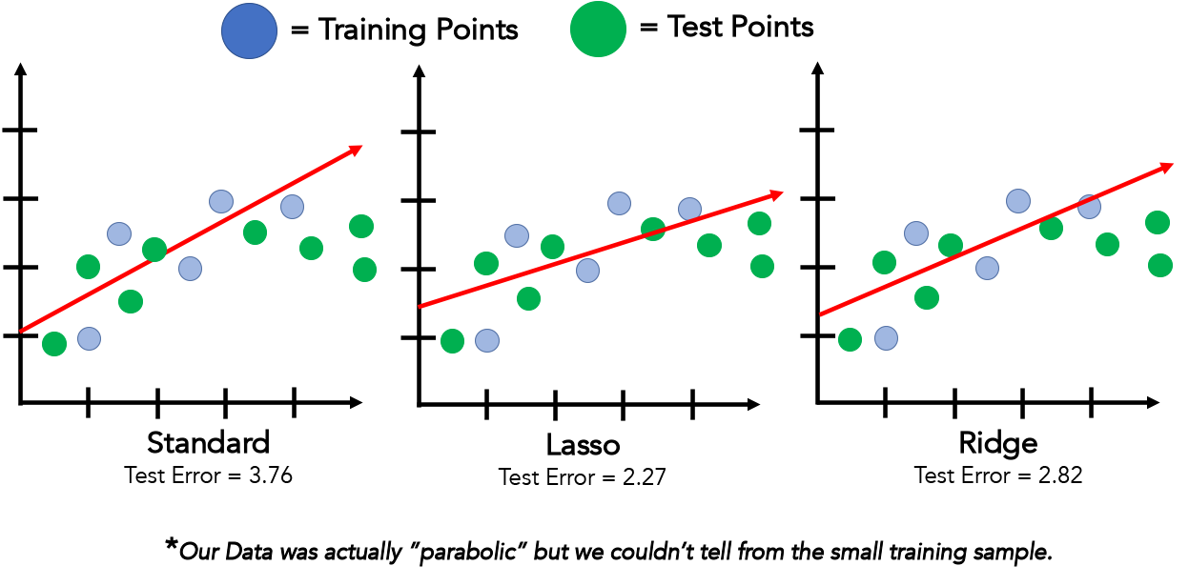
Some Data Points

Slide 9
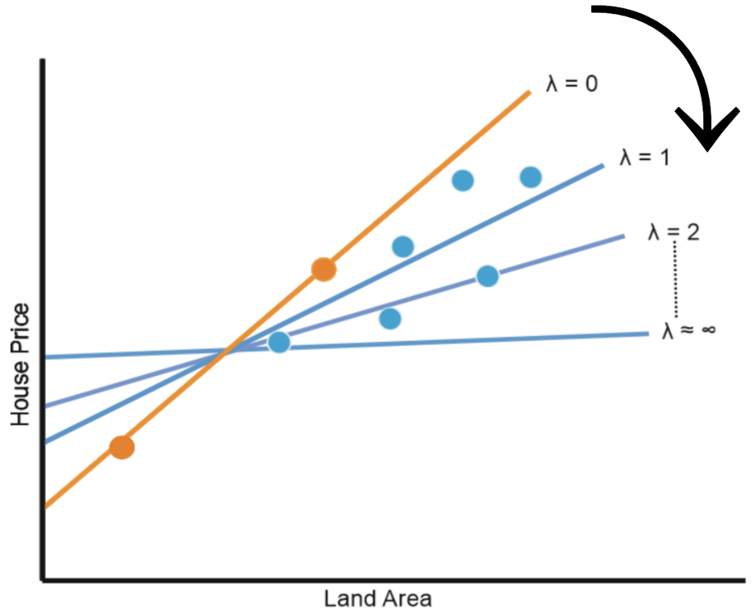

Example of Lasso Regression
$$α$$
The effect of Alpha on Lasso regression is similar to its effect on ridge regression
As Alpha increases, the slope of the regression line is reduced and becomes more horizontal.
As Alpha increases, the model becomes less sensitive to the variations of the independent variable (# Years of experience)
Salary
Experience

Slide 10
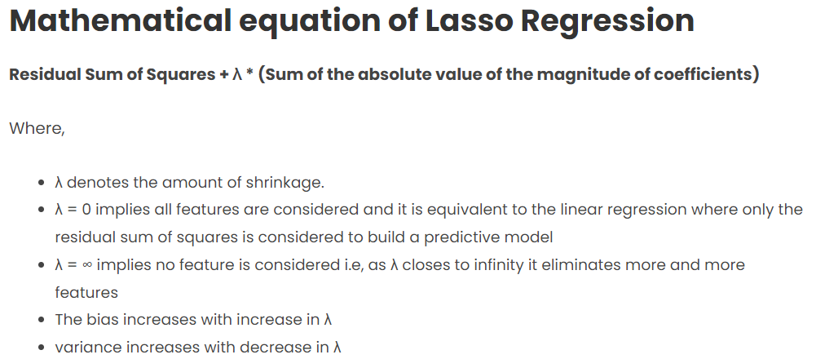
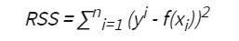
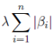
MATHEMATICAL REPRESENTATION

Slide 11
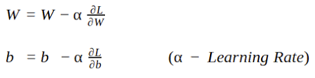
Gradient Descent:
Gradient Descent is an optimization algorithm used for minimizing the loss function in various machine learning algorithms. It is used for updating the parameters of the learning model.
Learning Rate:
Learning rate is a tuning parameter in an optimization algorithm that determines the step size at each iteration while moving toward a minimum of a loss function.

Slide 12
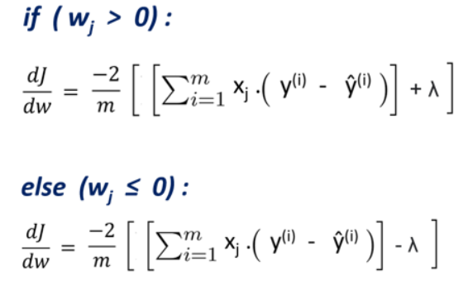
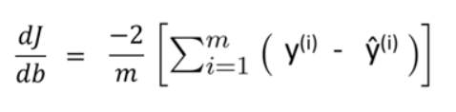
Gradient for Weights Gradient for Bias

Slide 13
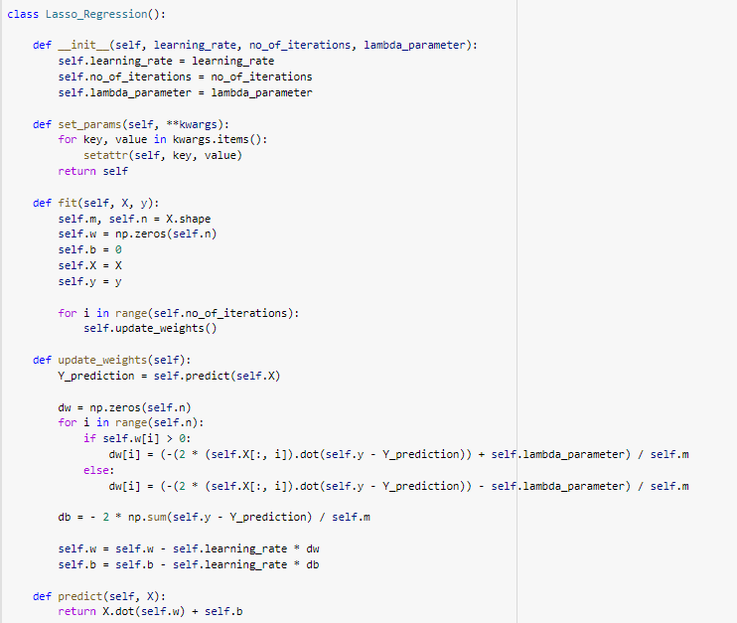
CODING

Slide 14
This creates a new class called Lasso_Regression.
Next is the constructor method for the class. It initializes the hyperparameters of the Lasso Regression model, which are the learning rate, the number of iterations, and the lambda parameter.
Next is the fit method that fits the training dataset to the Lasso Regression model. It initializes the weights and the bias term to zero, then sets the input feature matrix X and target vector Y. It then updates the weights and bias term by calling the "upadte_weights" method in each iteration of the gradient descent algorithm.
Next method updates the weights and bias term according to the gradients of the cost function. It calculates the predicted values of the target variable Y using the current weights and bias term. Then, it computes the gradients of the cost function with respect to the weights and bias term. Finally, it updates the weights and bias term using the learning rate and the gradients.
Next method predicts the target variable Y given an input feature matrix X. It computes the dot product of the input feature matrix X and the weight vector w, then adds the bias term b.

Slide 15



*
MODEL BUILDING
WHAT WE ARE WORKING ON
ANALYSIS
PREDICTION
DATA
Collecting the data from resources
Data Preprocessing, model building
Make good prediction with accuracy

Slide 16
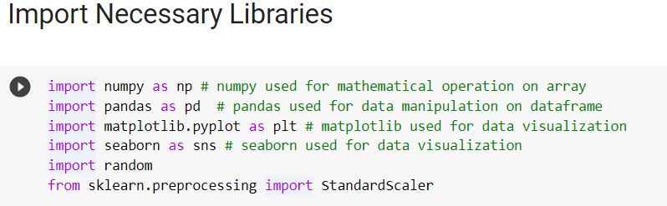
*
Load libraries
Both Pandas and NumPy provide a wide range of functions for manipulating and analyzing data, including functions for handling missing data, grouping data, merging datasets, and filtering data.
Matplotlib is a popular Python library used for creating visualizations and plots.
Seaborn is a popular Python library for creating statistical visualizations
Warnings to ignore warnings

Slide 17
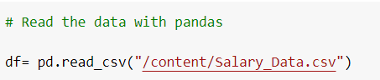
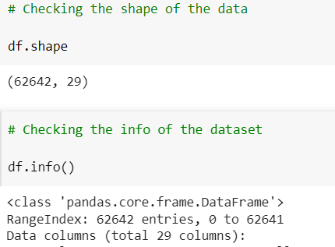
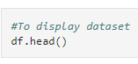
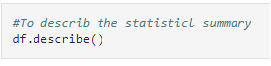
*
Reading the dataset
Used Salary dataset to predict how experience will boost up the salary.
It can help us better understanding of the data, communicate findings, identify outliers and anomalies, support better decision-making, and facilitate exploratory data analysis.
EDA :-

Slide 18
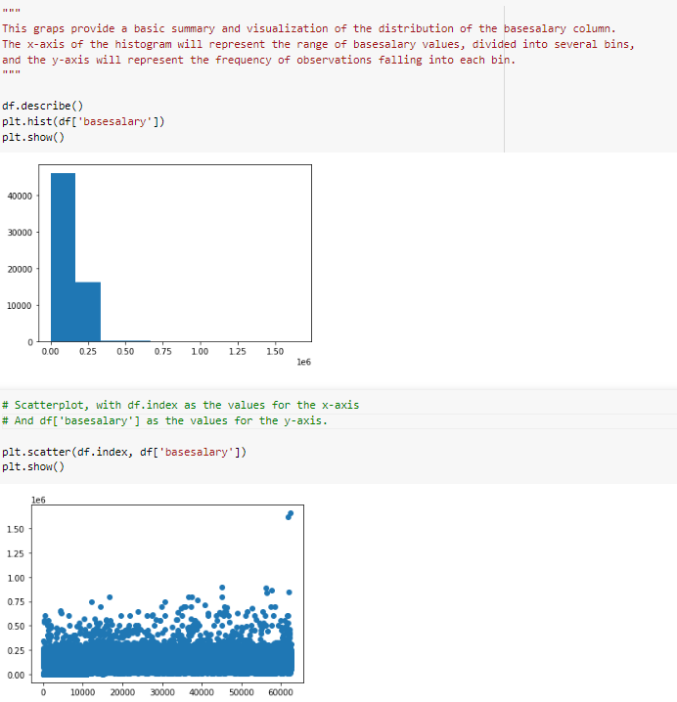
Data Visualization
Data visualization is the graphical representation of information and data

Slide 19
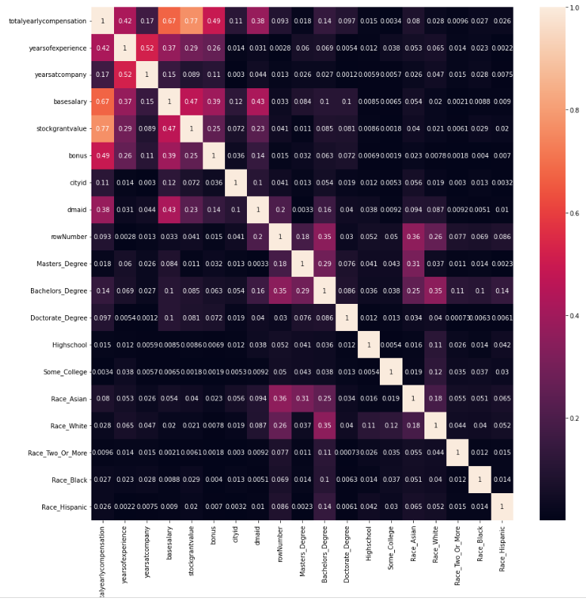

Slide 20
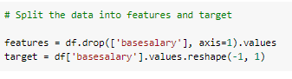
*
Feature Engineering
Feature engineering is the process of transforming raw data into features that can be used as input to machine learning models to improve their performance on a given task. It involves selecting, extracting, transforming, and creating features from the raw data that can capture the relevant information and patterns that are useful for the machine learning algorithm.

Slide 21
*
Data Splitting
By splitting the dataset into training and testing sets, we can train the machine learning model on the training set and evaluate its performance on the testing set. This helps us to estimate how well the model is likely to perform on new, unseen data.

Slide 22
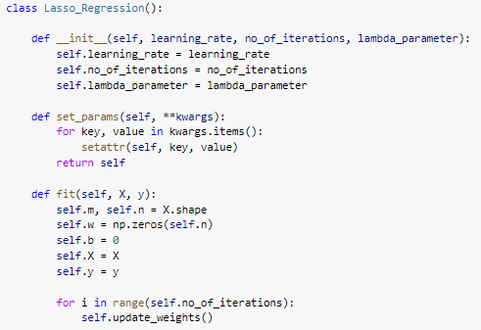
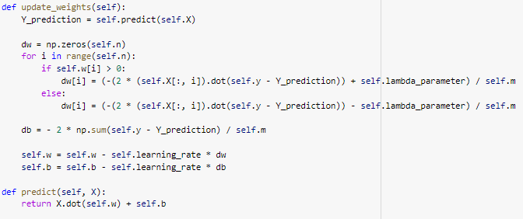
*
Model Building

Slide 23
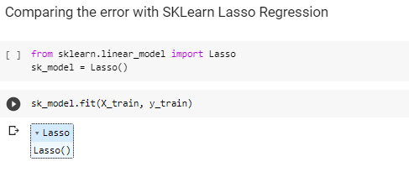
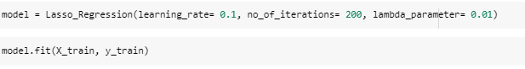
*
Model Evaluation
With using SKLearn Library
Without using SKLearn Library
Or
From the Scratch Code

Slide 24
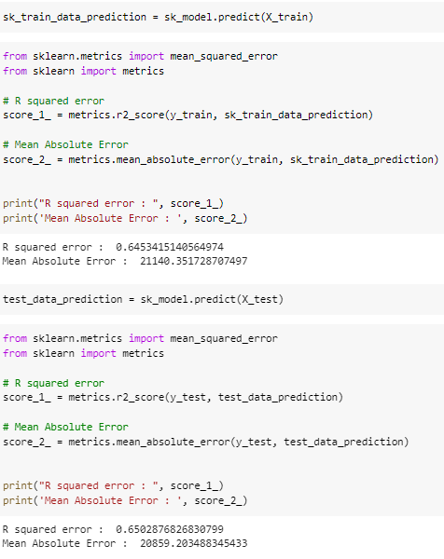
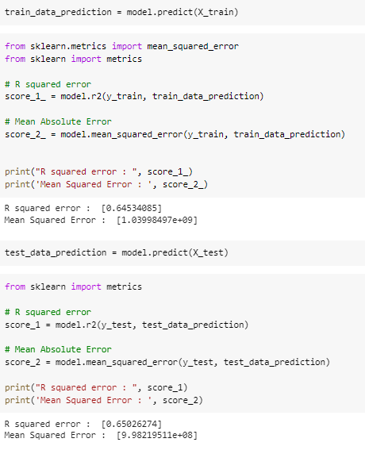
*
With using SKLearn Library
Without using SKLearn Library Or From the Scratch Code

Slide 25
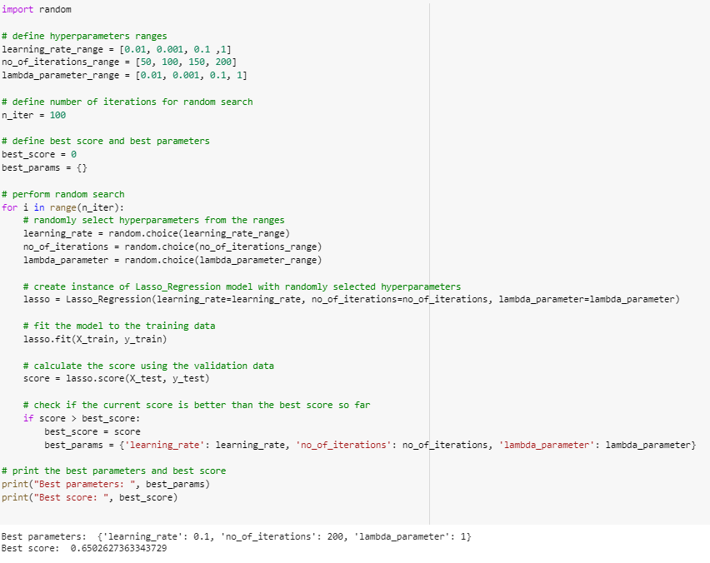
*
Model Tuning
Hyperparameter tuning involves searching over a range of possible values for each hyperparameter and evaluating the performance of the model on a validation set for each combination of hyperparameters

Slide 26
*
Working on datasets
1
2
3
4
5
Forest Fires
Google play
Housing dataset
Student dataset
Suicide dataset

Slide 27
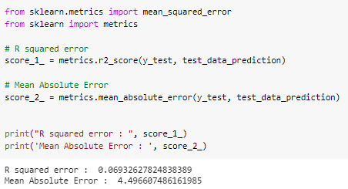
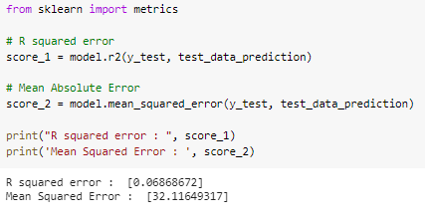
*
Forest Fires Dataset
Problem Statement :- predict the burned area of forest fires, in the northeast region of Portugal, by using meteorological and other data.
With using SKLearn Library
Without using SKLearn Library Or From the Scratch Code

Slide 28
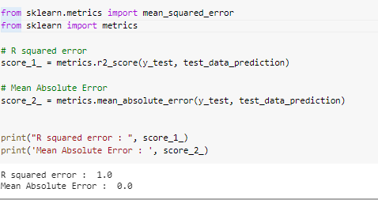
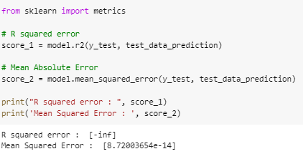
*
*
Googleplay Dataset
Problem Statement :- we are aiming to understand the trend of current Google Playstore market, Because as a developer, I should know the best constraints to focus on when launching my first app :D . And I definitely have no intention of getting lost in this vast ocean of versatile apps XD
With using SKLearn Library
Without using SKLearn Library Or From the Scratch Code

Slide 29
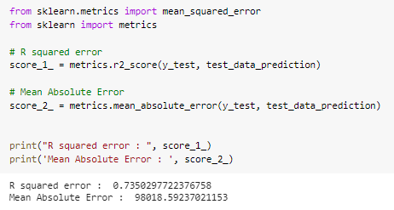
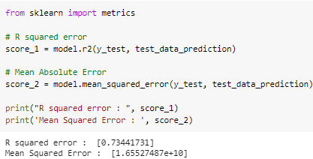
*
House sales Dataset
Problem Statement :- In this dataset we have to predict the sales price of houses in King County, Seattle. It includes homes sold between May 2014 and May 2015. Before doing anything we should first know about the dataset what it contains what are its features and what is the structure of data.
With using SKLearn Library
Without using SKLearn Library Or From the Scratch Code

Slide 30
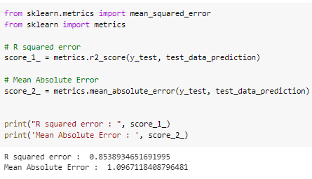
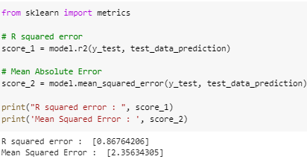
*
*
Student Performance Dataset
Problem Statement :- To predict students' final performance classification
With using SKLearn Library
Without using SKLearn Library Or From the Scratch Code

Slide 31
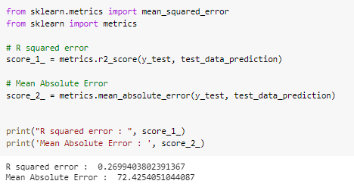
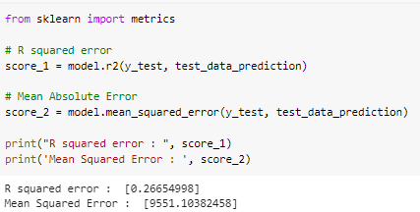
*
Suicide Prevention Dataset
Problem Statement :- Suicide Prevention.
With using SKLearn Library
Without using SKLearn Library Or From the Scratch Code

Slide 32

*
USER INTERFACE
A user interface (UI) refers to the point of interaction between a user and a computer system or application.
It encompasses all the visual and interactive components that allow users to interact with and control software or hardware.
A good user interface is designed to be intuitive, easy to use, and efficient, helping users to complete their tasks quickly and easily.
Common UI components include buttons, menus, forms, icons, and dialogue boxes, as well as more advanced features such as touchscreens, voice commands, and gesture recognition.

Slide 33
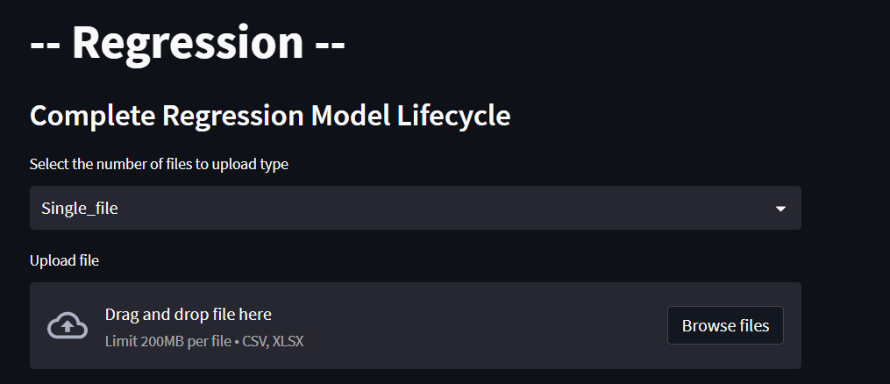
*
SNEAK PEAK
Building a user interface for a logistic regression model involves understanding the requirements of the model, collecting and preparing the data, training and testing the model, and building an interactive user interface that allows users to easily access the model's predictions.

Slide 34

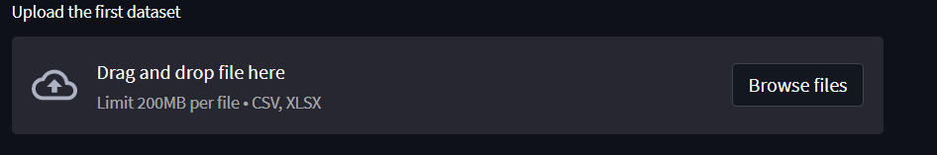
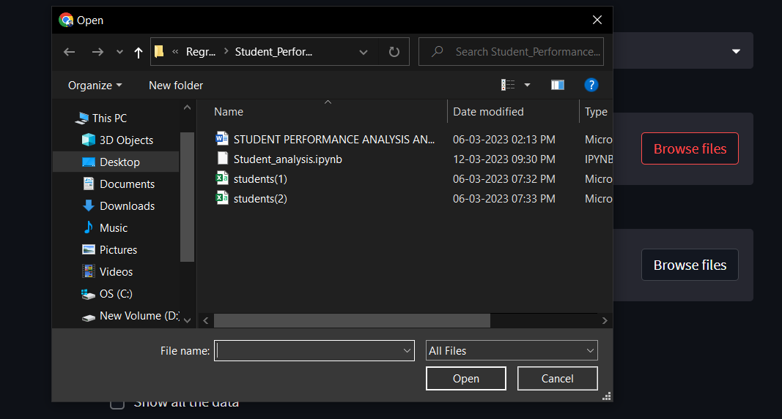
*
Button to upload dataset
Uploading the Dataset

Slide 35
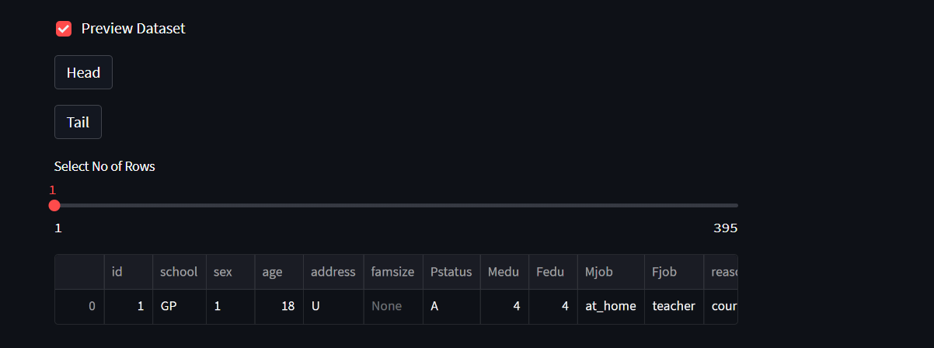
Displaying the Dataset

Slide 36
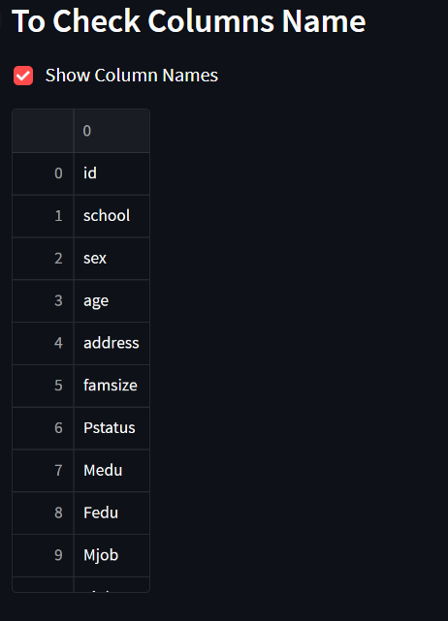
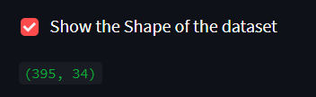
Checking the column name
Shape of the Dataset

Slide 37
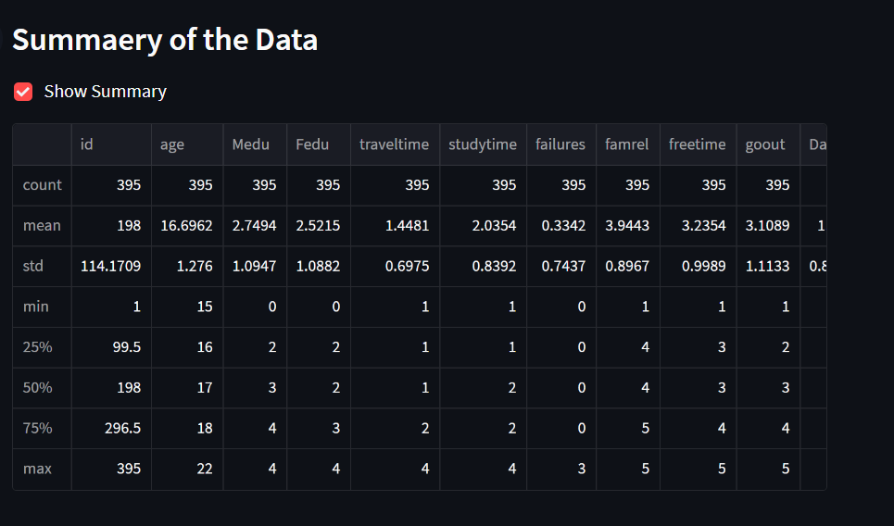
Summary of the Dataset

Slide 38
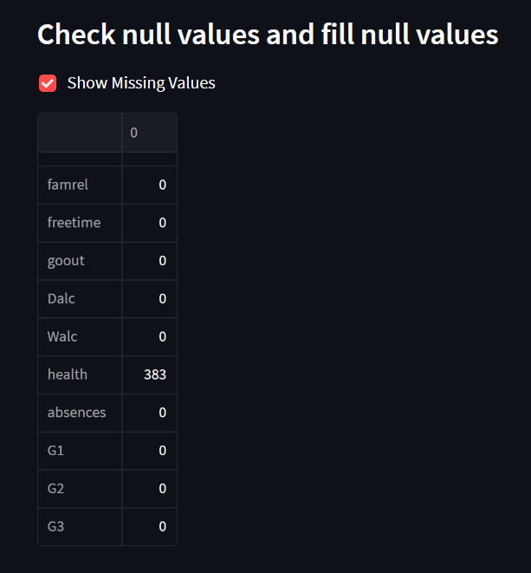
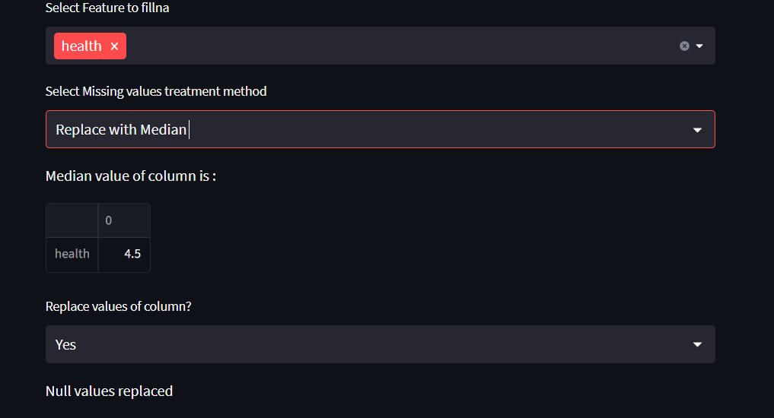
Checking the null values
Filling the null values

Slide 39
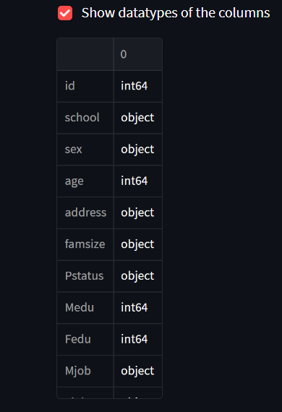
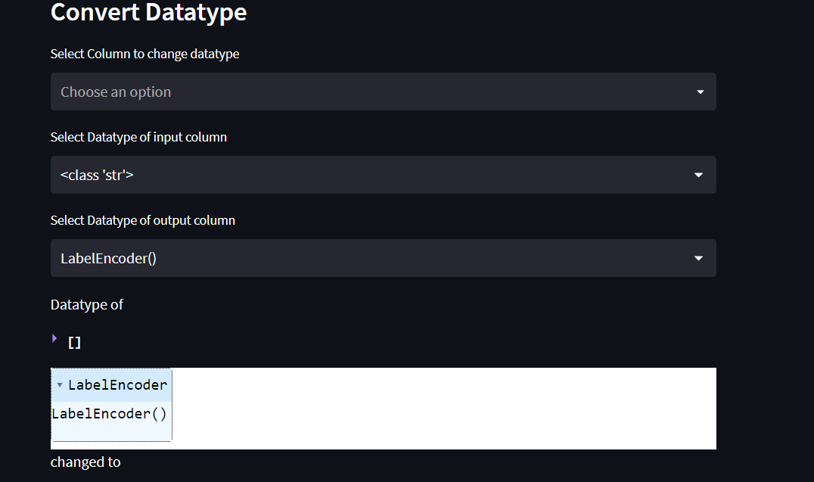
Show the datatype of the column
Conversion of the datatype

Slide 40
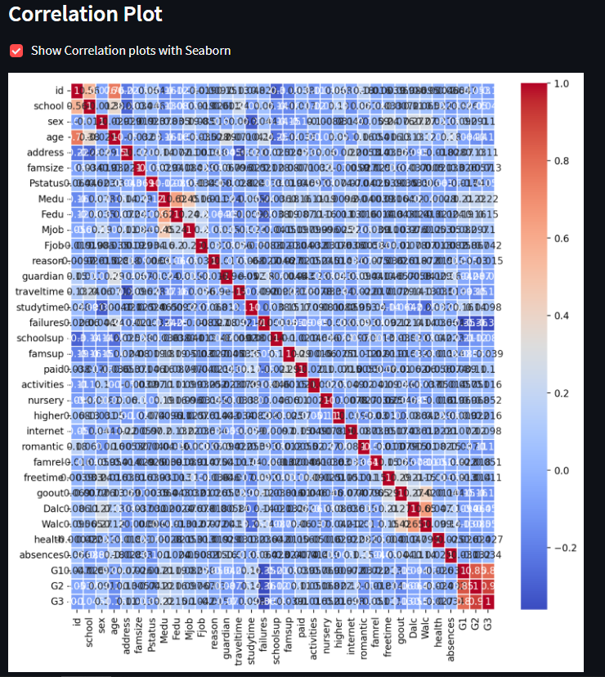
Correlation of the dataset

Slide 41
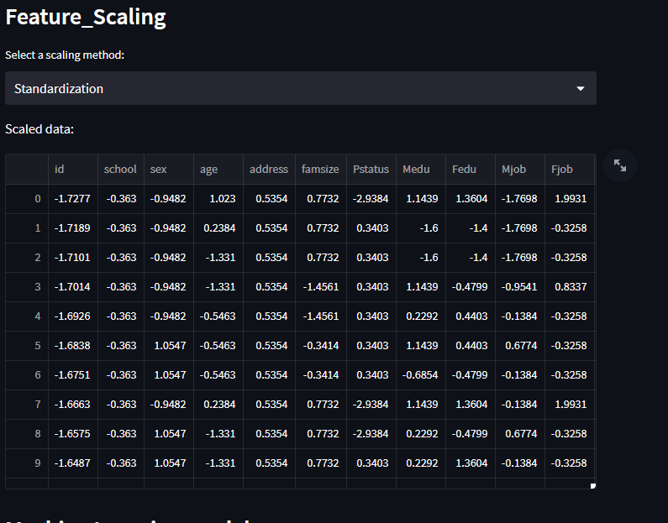
Feature scaling of the dataset

Slide 42
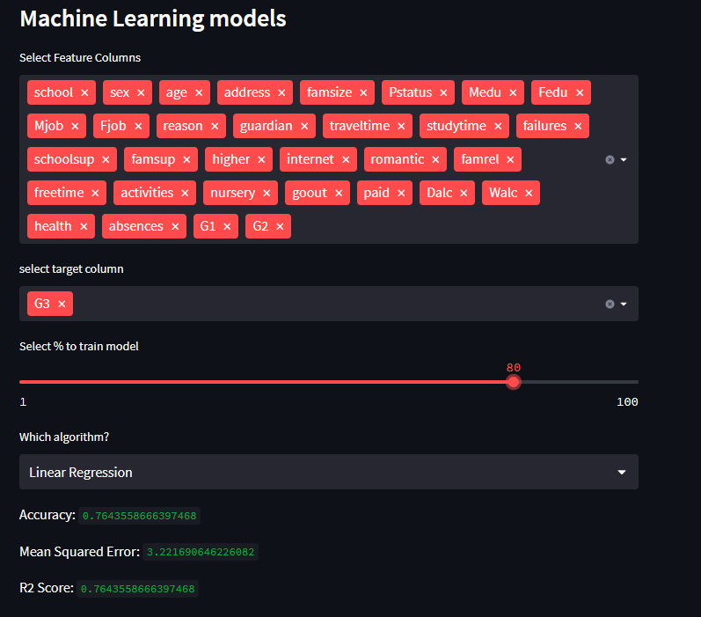
Selecting the feature column and target column

Slide 43
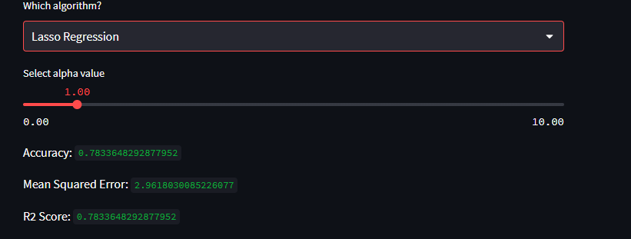
Selecting the algorithm
You can now view your Streamlit app in your browser.
Network URL: https://bharathgowdan-lasso-regression-ui-bgg98l.streamlit.app/

Slide 44
Thank You

